Slide 1
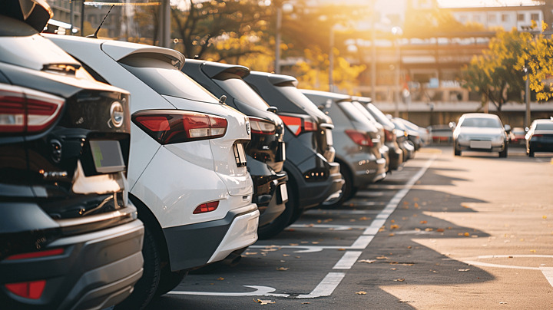
PARKING RESERVATION SYSTEM

Slide 2

"MEET THE TEAM"
LOHITH KUMAR.G
ROSELIN G.C
AP23110010261
AP23110010272
REVANTH.M
S.SANTHOSH
AP23110010273
AP23110010255

Slide 3
ABOUT PROJECT
We’re on a mission to make parking hassle-free. Our goal is simple : find you a spot quickly . Our program locates open spaces fast, so you don’t waste time circling the block for parking. And when it comes to charges, we only charge for the time you actually park–no more paying for hours you didn’t use. Our aim? To take the stress out of parking and make if fair for everyone.

Slide 4

Modules
MAIN MODULE
PARKING
FEE PAYING & RETREVAL
PARKING STATUS

Slide 5
METHODOLOGIES
MAIN MODULE
PARKING
Input – choice
Output– display result of given options
1. Creates object of vehicle function and initializes entry time.
2. Display options
Input – vehicle registration number and Person name.
Output – displays if the car is successfully parked. It allocates a free spaced index for the vehicle.
PARKING STATUS
FEE PAYING &RETREVAL
Input – index
Output– charge to be paid
And it frees the index.
Displays the free and occupied index’s present in the given array.

Slide 6
TECHONOLOGIES
CTIME
It is a header file that declares a set of functions and manipulate date and time information.
inheritance
The capability of a class to drive properties and characteristics from antoher class.

Slide 7
CTIME
In c++, the <ctime> header provides several functions for working with time-related operations. Here are some commonly used functions from this header: time_t time(time_t* timer);
Returns the current calendar time as a time_t object. If timer is not a null pointer, the result is also stored in the object it points to. Example: time_t now =time(NULL);
Char*dt=ctime(&now);
struct tm*localtime(const time_t*timer);
Converts the given time represented as time_t to a string in the format ”Day Mon dd hh : mm: ss yyyy”. The returned string is a pointer to an internal static array, so it should be used or copied before subsequent calls to ctime.
Example:
time_t now=time(NULL);
char*dt= ctime(&now);
struct tm* localtime(const time_t*timer);

Slide 8
CTIME
Converts the given time represented as time_t to a tm structure representing local time. The tm structure has fields like year , month, day, hour, minute , second ,etc.
Example: time_t now=time(NULL); struct tm* localtime= localtime(&now); struct tm* gmtime(const time_t*timer);
Similar to localtime , but converts the given time to co-ordinate universal time(UTC).
Example: time_t now = time(NULL); struct tm* utctime=gmtime(&now);
size_t strftime(char*str , size_t count, const char* format, const struct tm* timeptr);

Slide 9
inheritance
The capability of a class to derive properties and characteristics from another class is called inheritance. Inheritance is one of the most important features of object-oriented programming. Inheritance is a feature in which, new classes. The new class created is called “derived class” or “child class” and the existing class is known as the “base class” or “parent class”.
Super class : The class whose properties are inherited by a subclass is called inherited by a subclass
is called Base class or super class.
Syntax :Class BaseClass {
//Base class member and methods
};
Sub class : The class that inherits properties from another class is called subclass or derived class.
Syntax :
Class DerivedClass: access-specifier BaseClass{
//Derived class members and methods
};
VEHICLE(PARENT CLASS)
CAR(DERIVED CLASS)
BIKE(DERIVED CLASS)

Slide 10

VEHICLE
CAR
PARKING
RETREVING
BIKE
PARKING
FEE PAYING
PARKING STATUS
RETREVING
FEE PAYING
PARKING STATUS
FLOWCHART

Slide 11
Future scope
We would like to create an application to arrange the parking slots in an unified order in busy malls which saves most of the time for parking in parking lots.

Slide 12
THANK YOU

